Slide 1
Utilizing Topographic Finance to Understand Volatility
Presented By
Dr. Paul Cottrell
Company: Reykjavik

Slide 2
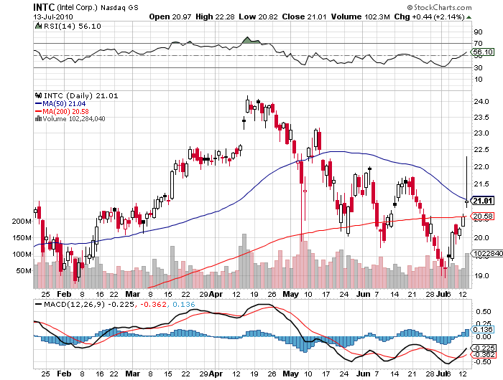
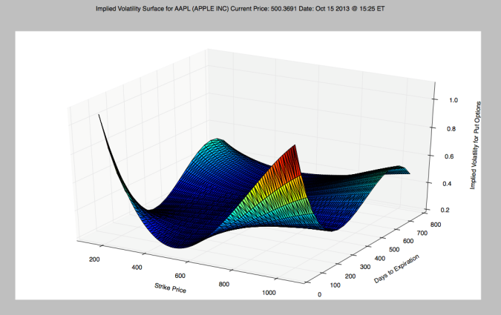
Introduction
Topographic finance is the study of surfaces to describe financial systems in multiple dimensions.
The problem with finance and economics
What is actually governing the price dynamics?
Price dynamics are behavioral and do not exhibit a rational maximization of a utility function (Mandelbrot and Hudson, 2004)
How to understand the inherited uncertainty
Volatility dynamics

Slide 3
Literature Review
Reflexivity can be defined as a theory describing a feedback mechanism on a particular system, whereby certain conditions might magnify effects or diminish them (Cottrell and Ungolo, 2015).
By utilizing symbols to represent direction and certain factors one can describe price dynamic in currency markets (Soros, 2003).
Irrational investors can be framed as a source of risk by defining the amount of holdings of an asset for a rational and irrational investor (Thaler, 1993).

Slide 4
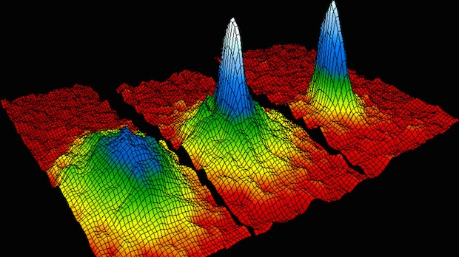
Literature Review
Options can be modeled using Brownian motion systems, whereby drift and volatility parameters are part of the Black–Scholes model (Black and Scholes, 1973).
Understanding the probabilities of the state-space we can improve on the forecasting of volatility near term when using a receding horizontal control and stochastic programming method (Cottrell, 2015).

Slide 5
Methodology
Longitudinal study
Independent Variables
Drift and Time
Dependent Variable
Volatility
Samples
S&P 500, West Texas Intermediate (WTI), and 10-year Treasury
Bi-harmonic surfacing is different than volatility surfacing of options.

Slide 6
The Dataset
Time Series
Daily closings from November 3rd , 2014 to February 27th, 2015.
From Federal Reserve Economic Data (FRED)
85 observations for each asset in consideration.
Procedure
Calculate
Log-returns (5-day moving window)
Volatility (5-day moving window)
Drift (5-day moving window)
Surface dataset utilizing 80 data points.

Slide 7
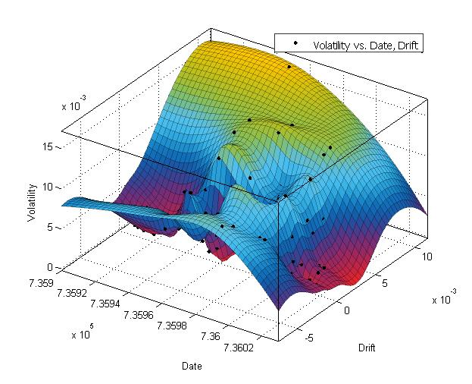
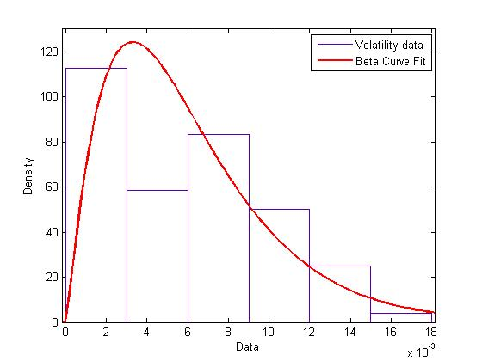
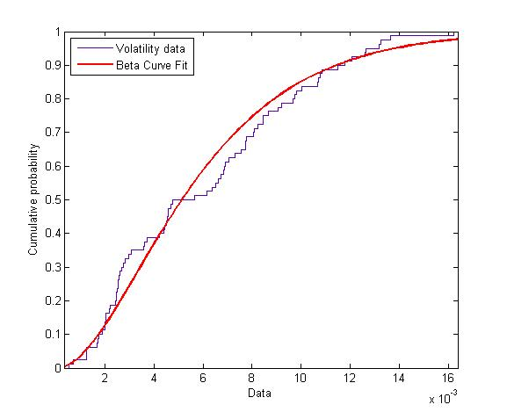
Results for S&P500

Slide 8
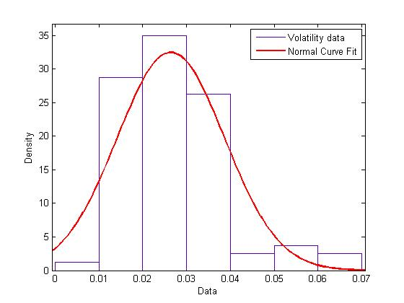
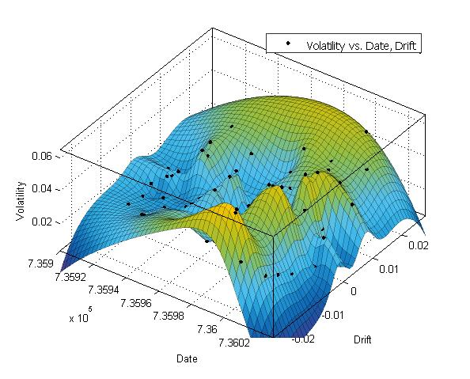
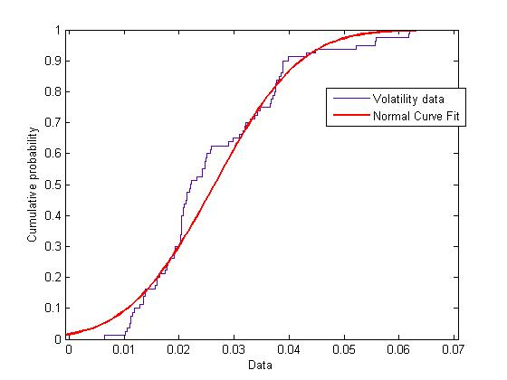
Results for WTI

Slide 9
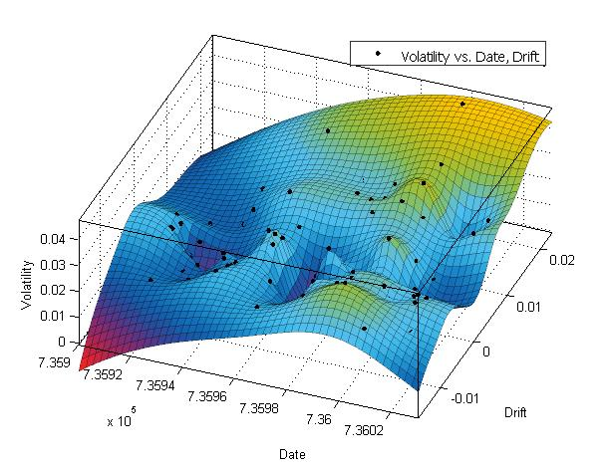
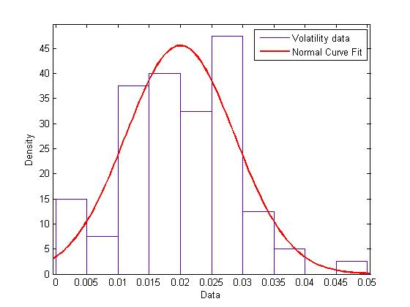
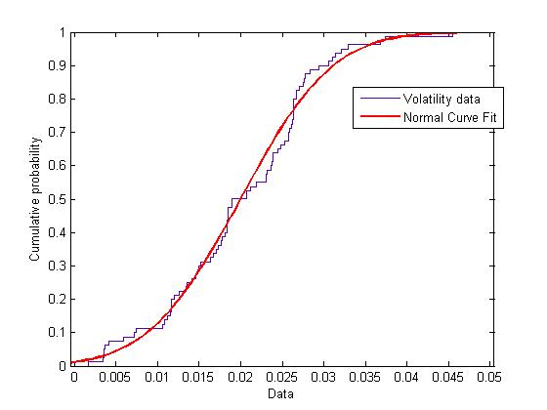
Results for 10-Year Treasury

Slide 10
Conclusion
Price dynamics can be described and forecasted utilizing a bi-harmonic spline interpolation methodology.
PDF and CDF graphs can help with determining the probability of changes in volatility and drift.
Future Studies
Utilizing GARCH methods in improving volatility prediction.
Develop methods to improve volatility spiking
Probabilities between certain regime switches
Utilization of artificial intelligence
Using cortical computing for learning to predict price dynamics.

Slide 11
Reference
Black, F., & Scholes, M. (1973). The valuation of options and corporate liabilities. Journal of Political Economy, 81(1), 637–654.
Cottrell, P. (2015). Dynamically hedging oil and currency futures using receding horizontal control and stochastic programming (Doctoral dissertation).
Mandelbrot, B. B., & Hudson, R. L. (2004). The (mis)behavior of markets: A fractal view of risk, ruin, and reward. New York, NY: Basic Books.
Soros, G. (2003). The alchemy of finance. Hoboken, NJ: John Wiley & Sons, Inc.
Thaler, R. H. (1993). Advances in behavioral finance. New York: Russell Sage Foundation.

Slide 12
Contact Information and Publications
Dr. Paul Cottrell
pauledwardcottrell@gmail.com
www.the-studio-reykjavik.com
@paulcottrell (Twitter)
Paul Cottrell (YouTube)

