Slide 1
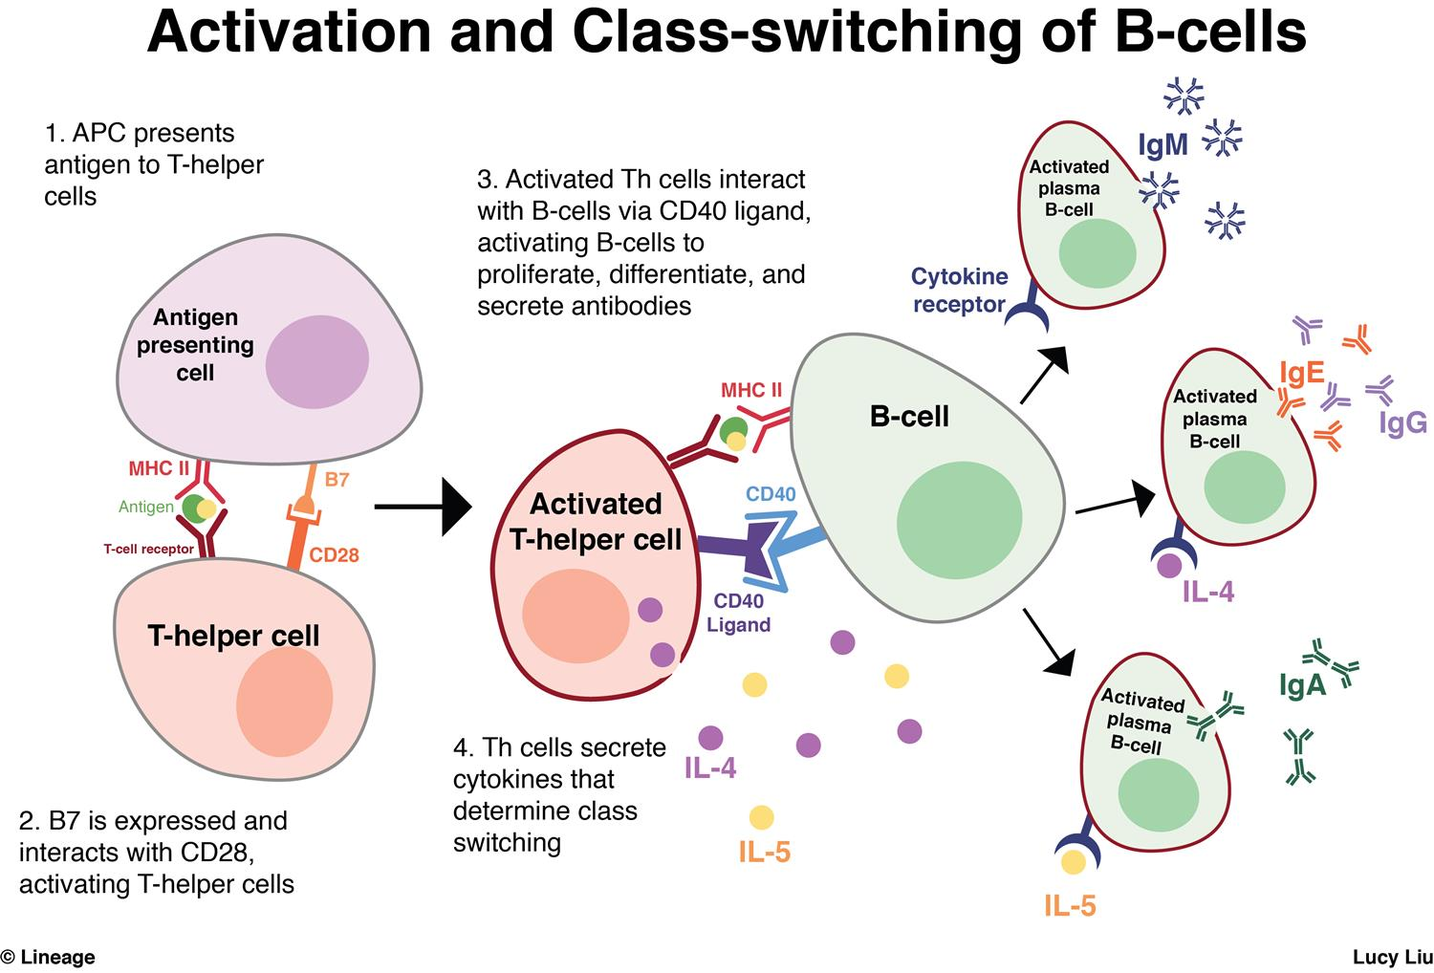

Slide 4
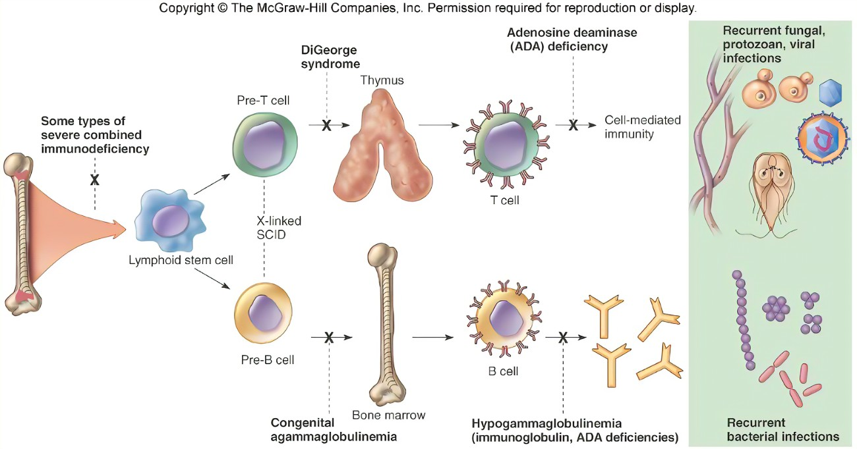

Slide 5
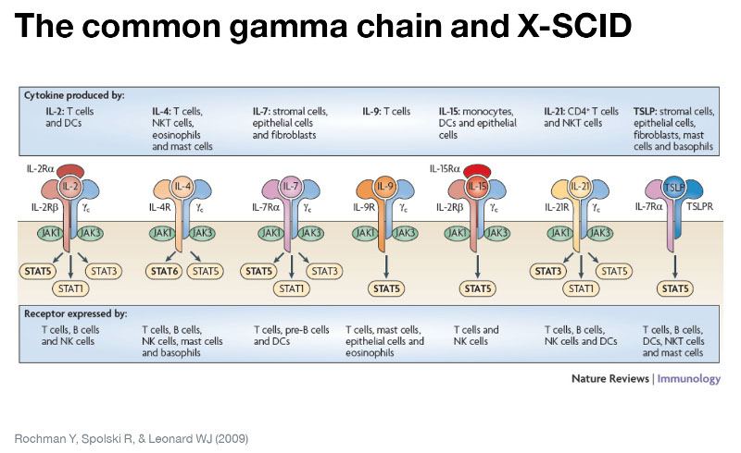

Slide 7
AIDS-Like Syndrome
CVID
SCID
Other
COVID-19
Vaccine
SARS-CoV-2

Slide 8
CVID
Deletion of genes
Surface proteins and cytokine receptors
CD19, 20, 21, 80
T-Cell Defects
In lower cell proliferation
Seems to be due to a multi genetic mutation landscape
Mutations in the genes encoding ICOS, TACI, CD19, CD20, CD21, CD80, and BAFFR
ICOS - Inducible T-cell costimulator
TACI - Transmembrane activator and CAML interactor
BAFFR - (B-cell activating factor receptor
MHCII mutations

