Slide 1
Cortical and Subcortical Computing for Financial Trading
Presented By
Dr. Paul Cottrell
Company: Reykjavik

Slide 2
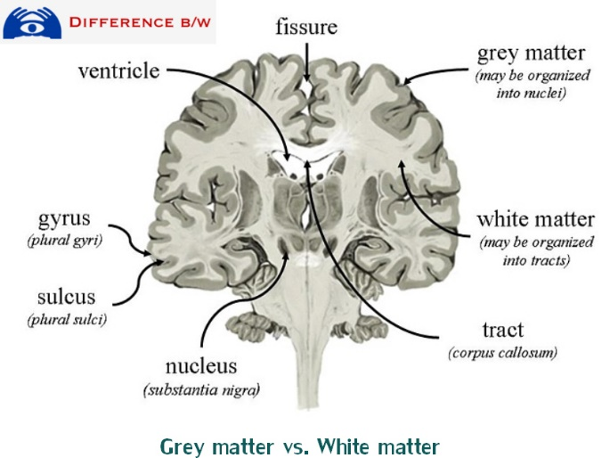
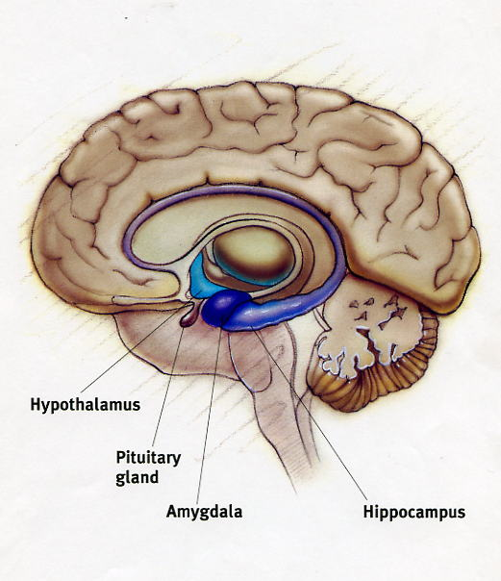
Introduction
Cortical computing is defined as the use of neural networks to store and process data, which is similar to how the neo-cortex performs activities. (gray matter)
Subcortical computing is defined as the use of primitive neural activity to store and process data, which is similar to how the limbic system performs activities. (emotion)
Cortical and subcortical computing can be used for algorithmic trading of financial markets

Slide 3
Literature Review
Sparse distributed representations can code patterns from input signals (Numenta, 2011).
Hierarchical temporal memory can be utilized for pattern recognition and prediction (Numenta, 2011).
An artificial intelligent system can be developed utilizing similar neurological processes in the human brain pertaining to neural connections (Hawkins and Blakeslee, 2004).
Artificial neural networks can be utilized for machine learning when using backward propagation (Rumelhart and McClelland, 1986)

Slide 4
Literature Review
Evolutionary algorithms became computationally feasible (Goldberg, 1989)
The Selfridge pandemonium is a pathway of higher sematic understanding of inputs (Minsky and Papert, 1969). The Selfrige pandemonium is similar to the Numenta concept of the hierarchal temporal memory architecture.
The use of a flexible probability between knowledge nodes can allow for pattern recognition and neural plasticity (Geortzel et al., 2012).

Slide 5
Methodology
Longitudinal study
Independent Variables
SDR variables (NT charts, Time, Profit, Trading Type, Etc.)
Dependent Variable
Performance relative to buy/hold strategy
Samples
West Texas Intermediate (WTI) from January 3, 2005 through April 21, 2015.

Slide 6
The Dataset
Time Series
Daily closings from January 3rd , 2005 through April 21st, 2015.
From Federal Reserve Economic Data (FRED)

Slide 7
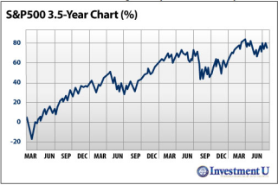
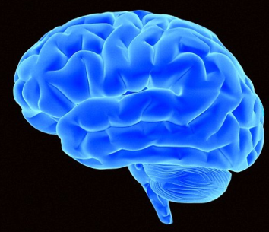
New Cognitive Architecture
Algo #n
Buy
Sell
SDR*
Data
Hold
Theoretical Framework: Pattern recognition via emotional states and trial & error.
Profit / Loss
+ Association / - Association
Neurotransmitter
Chart
*Sparse Distributed Representations (SDR)

Slide 8
Neurotransmitters
Neurotransmitter Chart
Association | Value Range
Change | 0 or 1
Stay | 0 or 1
Fear | 1-99
Danger | 1-99
Surprise | 1-99
Trauma | 1-99
Protective | 1-10 (1 = high risk aversion)

Slide 9
SDR Data
SDR
Data
Store in a data structure
Node Name
+/- association of result on account value
Behavior (buy/sell/hold)
Neurotransmitter Chart
Emotional State
Time stamp
Data from the algorithm
Delta of forecast and market price
Variable values and parameters for the Algorithm
SDR has a complete history. Fresher SDR data used in
referencing decisions.
SDR
Old Data
SDR
Fresher Data

Slide 10
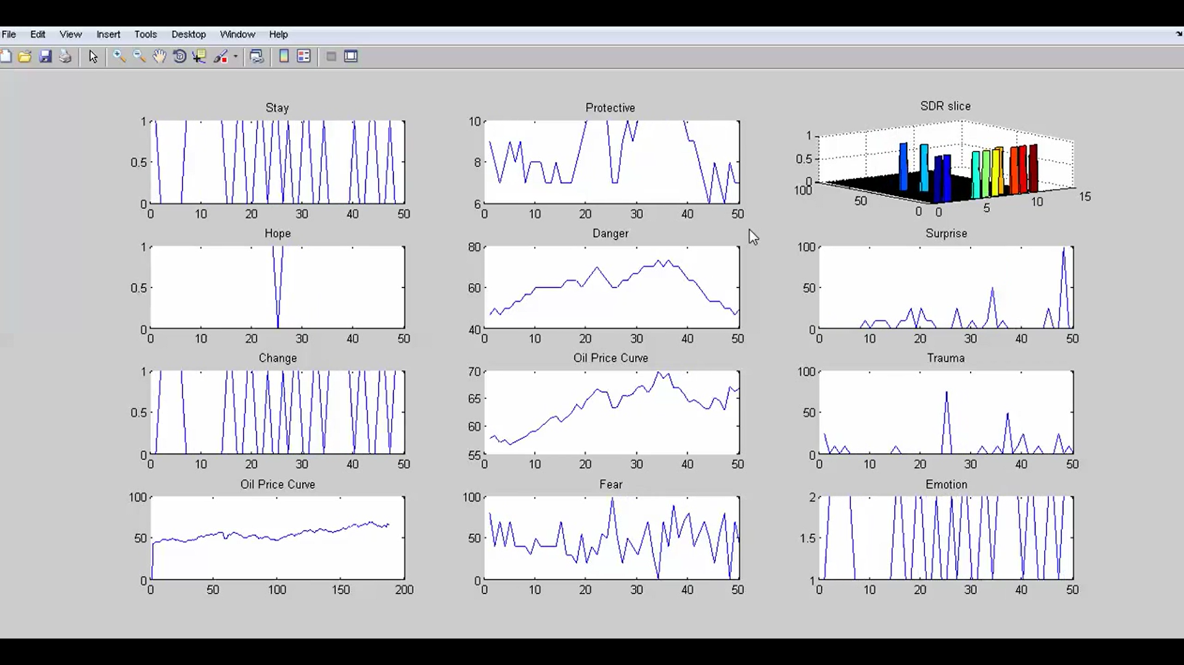
Artificial Intelligence - EEG

Slide 11
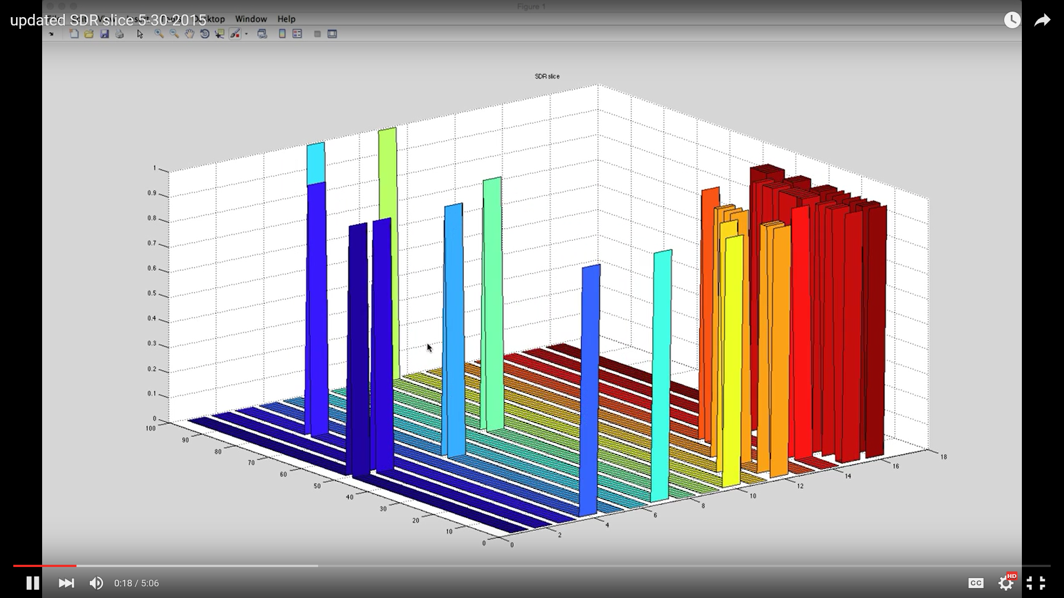
SDR Slice

Slide 12
Oil Trading Performance
AI performs better than a buy and hold strategy

Slide 13
Conclusion
When trading the oil market an artificial intelligent system utilizing cortical and subcortical computing can perform better than a buy and hold strategy between Jan 3, 2005 through April 21, 2015.
A cortical and subcortical algorithmic system can recognize patterns in a dataset, and therefore can be utilized to do automatic adjustments per an objective function.
The computer code overhead is not substantial for trading individual markets.
Adding cortical tissue layers seem to allow for more sematic understanding of environment for better trading determination.

Slide 14
Reference
Geortzel, B., Pennachin, C., & Geisweiller, N. (2012). Building better minds: Artificial general intelligence via the CogPrime Architecture.
Goldberg, D. E. (1989). Genetic algorithm in search, optimization, and machine learning. Addison-Wesley.
Hawkins, J., & Blakeslee, Sandra. (2004). On intelligence: How a new understanding of the brain will lead to the creation of truly intelligent machines . New York, NY: Henry Holt and Company. LLC.
Minsky, M. & Papert, S. (1969). Perceptrons: An introduction to computational geometry. Cambridge, Mass.: MIT Press. ISBN 02622630222.
Numenta (2011). Hierarchical Temporal Memory (White Paper).
Rumelhart, D. & McClelland, J. (1986). Parallel Distributed Processing. Cambridge, Mass.: MIT Press.

Slide 15
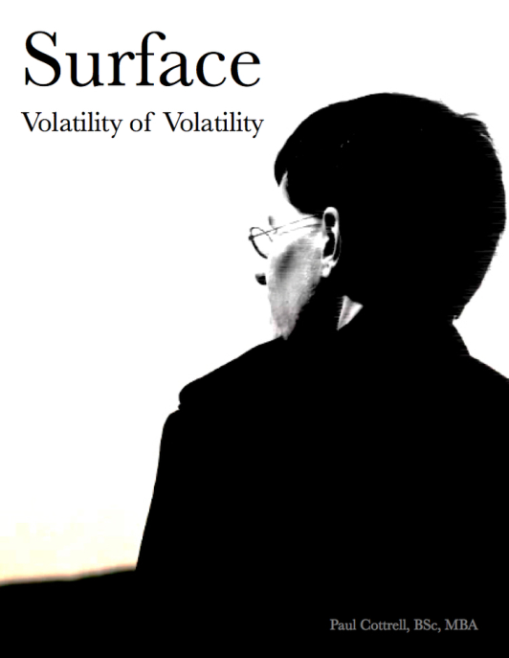
Contact Information and Publications
Dr. Paul Cottrell
pauledwardcottrell@gmail.com
www.the-studio-reykjavik.com
@paulcottrell (Twitter)
Paul Cottrell (YouTube)

